Slide 1
PROJECT REVIEW - 2
Retail Analytics Using Machine Learning,
Customer Intelligence.
An end-to-end analytics pipeline on the Global Superstore dataset: preprocessing, EDA, feature engineering, regression modelling, RFM segmentation, CLV estimation, scenario simulation and an interactive Power BI dashboard.
51,290
4
1,590
6
Transaction records
Regression models
Customers profiled
Dashboard pages
Dataset: Global Superstore (2011-2014) | Tools: Python, scikit-learn, XGBoost, MySQL, Power BI
Notes:
Review-2 presentation. All figures in this deck were extracted directly from the project output files (Excel outputs, model comparison files and the .pbix report definition).

Slide 2
Project Overview and Dataset
Global Superstore transactional retail data, 2011-2014
51,290
24 to 51
25,035
1,590
Rows (raw and retained)
Columns: raw to engineered
Unique orders
Unique customers
Dataset characteristics
Problem addressed
Source file: data/Global_Superstore.csv, read with latin-1 encoding
Period covered: 01 Jan 2011 to 31 Dec 2014 (48 months)
10,292 unique products across 3 categories and 17 sub-categories
147 countries grouped into 7 markets and 13 regions
3 customer segments: Consumer, Corporate, Home Office
Descriptive reporting alone does not explain what drives sales
Customer value is not visible from raw transaction tables
Pricing and quantity decisions are made without simulation support
Outputs are scattered across files instead of one decision surface
Objective
To build a reproducible analytics pipeline that cleans retail transaction data, explains historical performance, predicts transaction-level sales, classifies customers by behavioural value, estimates customer lifetime value, simulates discount and quantity changes, and presents the results through an interactive Power BI dashboard.
Notes:
Row count verified: raw CSV and all downstream files contain 51,290 rows. Duplicates found = 0, so no rows were dropped.

Slide 3
Methodology
End-to-end workflow, part 1 of 2 - data pipeline and modelling
Raw Dataset
Global_Superstore.csv: 51,290 transaction records from 2011-2014, loaded with Latin-1 encoding.
1
Global_Superstore.csv
Preprocessing
Cleaned with pandas - missing values median/mode-imputed, duplicates removed, dates parsed, and Sales/Quantity/Discount/Profit capped by IQR. Result: 0 missing, 0 duplicates, 0 invalid dates.
2
preprocessing.py
Exploratory Analysis
Univariate, bivariate and multivariate analysis on the preprocessed dataset - 24 result tables and 30+ charts covering sales, profit, discount and customer patterns.
3
eda.py
Feature Engineering
27 engineered features across five groups (date, sales, customer, product, profit) built on the preprocessed data - columns grow from 24 to 51.
4
feature_engineering.py
Feature Selection
Numerical, categorical, variance and correlation screening (0.80 threshold) run as a parallel study - the ML script defines its own predictor list rather than consuming this output.
5
feature_selection.py
Machine Learning
80/20 train-test split; Linear Regression, Decision Tree, Random Forest and XGBoost compared - XGBoost best at MAE 32.85, RMSE 57.04, R² 0.9116.
6
machine_learning.py
Notes:
Verified from the input/output paths declared at the top of each script.

Slide 4
Methodology (continued)
End-to-end workflow, part 2 of 2 - customer intelligence and deployment
RFM Intelligence
Quintile scoring of Recency, Frequency and Monetary for all 1,590 customers - RFM score 3 to 15, grouped into High / Medium / Low value bands.
7
rfm_analysis.py
CLV Estimation
CLV = Average Order Value x Purchase Frequency x Estimated Lifespan - a historical behavioural estimate, not a predictive forecast.
8
clv_analysis.py
Scenario Analysis
Saved XGBoost model replayed on a fixed 1,000-row sample across discount levels (0-50%) and quantity values (1-12) to observe the predicted-sales response.
9
discount / quantity
MySQL Load
Sales-related fields loaded into retail_analytics.sales_data via pymysql, feeding the KPI and trend visuals in Power BI.
10
sql_database.py
Power BI Dashboard
Six interactive report pages - Overview, Product & Profit, Customer Intelligence, CLV, Scenario Analysis, Business Insights - built on MySQL and Excel sources.
11
6 report pages
Business Insights
Written summary across all six analytical themes, framing scenario outputs as model predictions rather than measured business outcomes.
12
decision support

Slide 5
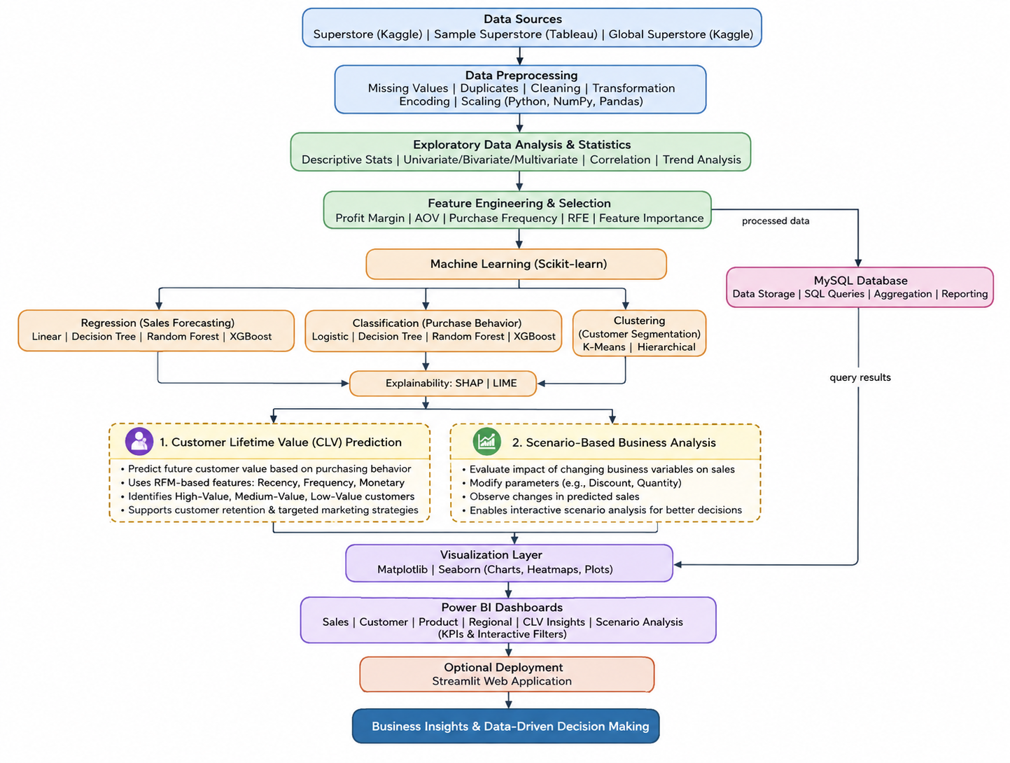
System Design

Slide 6
Modern Tools and Technologies
Only technologies evidenced in the project files are listed
Python 3
Core language for the entire pipeline; all nine analysis scripts
pandas
Loading, cleaning, grouping, merging and Excel export of every stage
NumPy
Vectorised arithmetic, np.where conditions, binning boundaries
Matplotlib
All saved EDA, model comparison and cluster charts (PNG, 300 dpi)
Seaborn
Statistical plot styling in the machine learning script
scikit-learn
Pipeline, ColumnTransformer, OneHotEncoder, StandardScaler, train_test_split, Linear Regression, Decision Tree, Random Forest, KMeans, metrics
XGBoost
XGBRegressor - the best performing model and the one persisted for scenarios
joblib
Serialises the fitted pipeline to Final_XGBoost_Sales_Model.pkl
MySQL + SQLAlchemy
retail_analytics database; sales_data table loaded via pymysql; sql_analysis.sql holds the business queries
openpyxl
Multi-sheet Excel writer used for every analytical output file
Power BI Desktop
Six-page interactive report with DAX measures and slicers
Microsoft Excel
Interchange format between Python stages and Power BI
VS Code
Development environment (project paths reference the local workspace)
requirements.txt lists pandas, numpy, matplotlib, seaborn, openpyxl and scikit-learn. XGBoost, joblib, SQLAlchemy and pymysql are imported in the scripts but are not listed in requirements.txt.

Slide 7
Implementation: Data Preprocessing
preprocessing.py - fourteen sequential blocks
Steps performed
Validation results
Load CSV with latin-1 encoding to handle special characters
Data quality assessment: dtypes, null counts, unique counts
Descriptive statistics for all numeric columns
Missing value analysis, then duplicate detection and removal
Whitespace stripping on every text column
Order Date and Ship Date converted with pd.to_datetime
Median imputation (numeric) and mode imputation (categorical)
IQR outlier detection, then capping of Sales, Quantity, Discount, Profit
Check | Result
Rows before / after | 51,290 / 51,290
Duplicate records found | 0
Missing values (raw) | 41,296 in Postal Code
Missing values (final) | 0
Invalid dates after conversion | 0
Rows removed by outlier step | 0 (values capped)
Effect of IQR capping - important caveat
Design choice: cap rather than delete
Raw totals: Sales 12,642,501.91 and Profit 1,467,457.29
After capping: Sales 8,840,302.23 and Profit 927,961.27
Capping therefore reduces total sales by about 30% and total profit by about 37%
All EDA, model and dashboard figures in this deck are post-capping values, not raw business totals
Extreme values were clipped to the IQR boundaries instead of removing the rows that contained them. Every one of the 51,290 transactions is therefore retained for analysis, which keeps order, customer and product counts intact. The trade-off is that the magnitude of large transactions is compressed, and that compression carries through to every downstream figure.
Postal Code is numeric, so its 41,296 missing values were median-imputed rather than dropped; the column is not used in any model.
Notes:
Raw vs capped totals were recomputed directly from Global_Superstore.csv and Feature_Engineered_Superstore.xlsx to confirm this caveat.

Slide 8
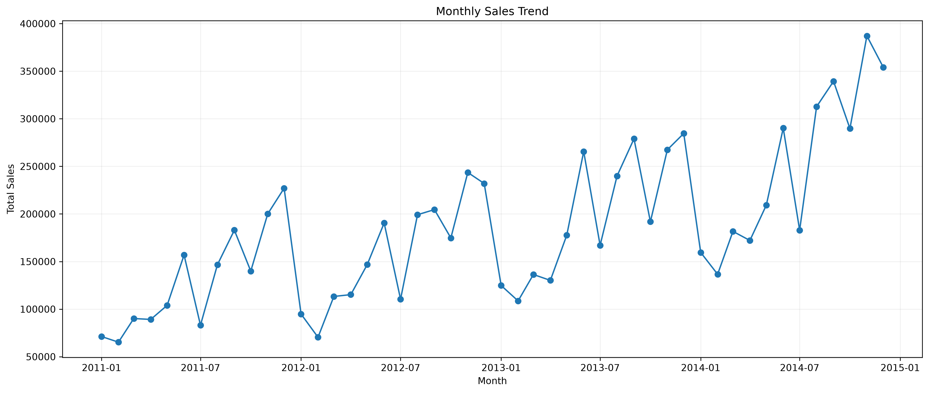
Implementation: Exploratory Data Analysis
eda.py - 24 result tables in EDA_Results.xlsx plus 30+ saved charts
Analyses produced
Univariate: Sales, Profit, Quantity, Discount, Segment, Category, Ship Mode, Order Priority
Bivariate: Sales vs Profit, Discount vs Profit, and by Category and Segment
Multivariate: Sales-Profit-Discount interaction, Category x Segment
Sales trend (monthly and yearly), profit analysis, product and regional performance
Customer behaviour, customer segmentation and correlation analysis
Year | Total Sales (capped)
2011 | 1,556,334
2012 | 1,895,526
2013 | 2,373,074
2014 | 3,015,368
Figure 1: Monthly sales trend, Jan 2011 - Dec 2014 (outputs/02_EDA/05_Sales_Trend)
Yearly totals aggregated from the Monthly_Sales sheet. Sales grow in every successive year across the four-year window.

Slide 9
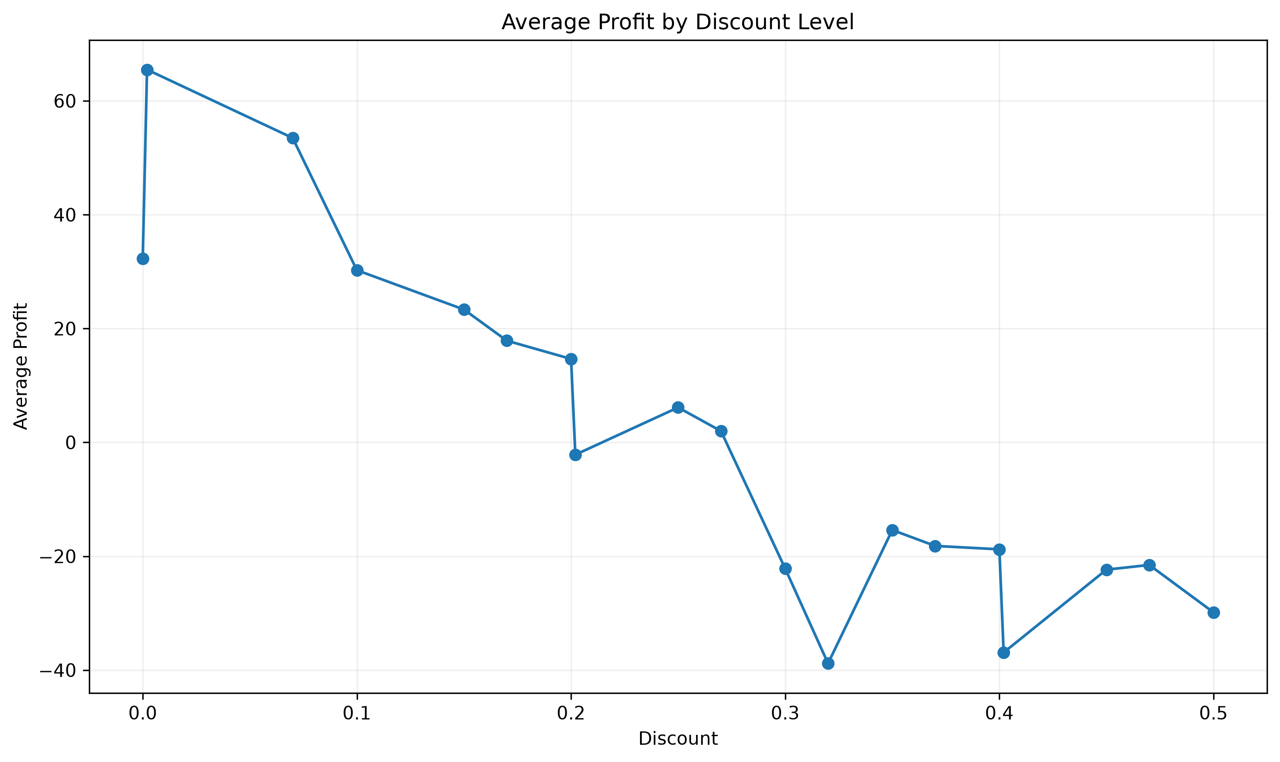
EDA: Key Findings
All values from EDA_Results.xlsx (post-capping)
8.84 M
0.93 M
-0.576
+0.483
Total sales (capped)
Total profit (capped)
Discount to Profit correlation
Sales to Profit correlation
What the numbers show
Category sales are close: Technology 3.08 M, Office Supplies 3.01 M, Furniture 2.75 M - but profit ranks differently, with Office Supplies highest at 392,508
Phones lead sub-category sales (1.04 M) and profit (107,358); Chairs sell 1.04 M but return only 83,188
Central is the strongest region on both sales (2.02 M) and profit (208,782); Southeast Asia sells 615,554 yet returns only 14,717
Consumer is the largest segment: 4.56 M sales, 475,572 profit, 13,104 orders
Discounts above 30% are associated with negative total profit; at 50% discount total profit is -173,380
Figure 2: Average profit by discount level (outputs/02_EDA/10_Discount_Analysis)
Correlation and profitability patterns are associations observed in historical data. They are not causal estimates.

Slide 10
Implementation: Feature Engineering and Selection
27 engineered features take the dataset from 24 to 51 columns
Date features (9)
Order Year, Order Month, Order Month Name, Order Quarter, Order Week, Order Day of Week, Order Day Name, Is Weekend, Shipping Days
Feature selection approach
Numerical screening: mean, standard deviation, variance, range and unique counts
Categorical screening: unique value and missing value counts
Correlation matrix over all numeric features, exported with a heatmap
High-correlation pairs flagged at an absolute threshold of 0.80
Constant (single-value) features identified for removal
Sales features (5)
Sales per Quantity, Discount Amount, Net Sales, Quantity Category, Discount Category
Customer features (5)
Customer Order Count, Customer Total Sales, Customer Total Profit, Customer Average Order Value, Customer Profitability
Product features (5)
Product Order Count, Product Total Sales, Product Total Profit, Product Average Sales, Product Performance
Honest note on selection
The selection script writes Final_Selected_Features.xlsx, but machine_learning.py does not read that file. It instead declares its own candidate predictor list and filters it against the feature-engineered dataset. Feature selection therefore functioned as an exploratory screening study rather than as an automated gate feeding the models.
Profit features (3)
Profit Margin, Profit Status, Profit Category
Notes:
Verified by comparing the INPUT_FILE constant in machine_learning.py with the output path in feature_selection.py.

Slide 11
Implementation: Machine Learning Approach
Target variable: Sales (continuous) - a regression problem
Modelling pipeline
Predictor variables used (22)
sklearn Pipeline wraps preprocessing and estimator together, so the same transform is applied at training and prediction time
ColumnTransformer: StandardScaler on numeric columns, OneHotEncoder on categorical columns
train_test_split with test_size = 0.20 and random_state = 42
Four regressors trained on identical inputs: Linear Regression, Decision Tree, Random Forest, XGBoost
Best model serialised with joblib for reuse in scenario analysis
Numeric: Quantity, Discount, Shipping Cost, Shipping Days, Order Year, Order Month, Order Quarter, Order Week, Order Day of Week, Is Weekend
Categorical: Ship Mode, Segment, City, State, Country, Market, Region, Category, Sub-Category, Order Priority, Quantity Category, Discount Category
Evaluation metrics
MAE - mean absolute error, average size of the error in currency units
RMSE - root mean squared error, penalises large errors more heavily
R squared - proportion of variance in Sales explained by the model
Accuracy is deliberately not reported: it is a classification metric and does not apply to this regression task
Dataset | Rows
Complete ML dataset | 51,290
Training set (80%) | 41,032
Testing set (20%) | 10,258
Table 1: Train / test split (Train_Test_Split_Summary.xlsx)

Slide 12
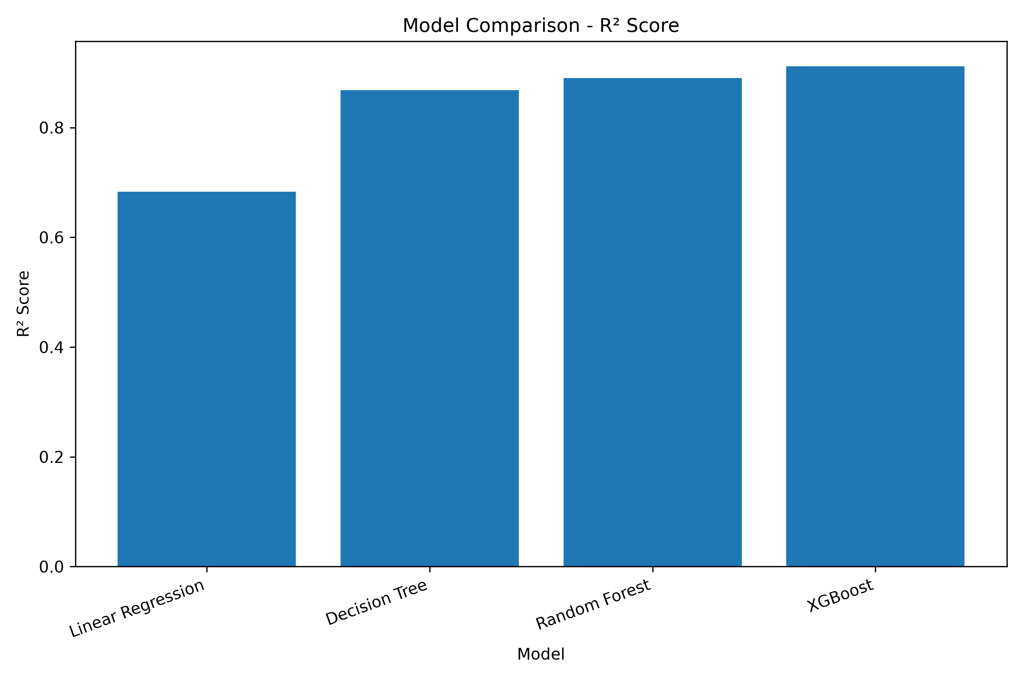
Results: Model Comparison
Metrics computed on the 10,258-row held-out test set
Model | MAE | RMSE | R squared
Linear Regression | 78.7126 | 108.0159 | 0.6830
Decision Tree | 36.8939 | 69.6571 | 0.8682
Random Forest | 34.3853 | 63.5656 | 0.8902
XGBoost | 32.8537 | 57.0368 | 0.9116
Table 2: Model comparison, exact values from Model_Comparison.xlsx
Reading the table
Figure 3: R squared by model (06_Model_Comparison)
XGBoost is best on all three metrics simultaneously - no metric disagreement
Moving from Linear Regression to XGBoost cuts MAE by about 58% and RMSE by about 47%
The gap between Linear Regression and the tree ensembles indicates meaningful non-linearity in the relationship between the predictors and Sales
Final_Model_Summary.xlsx independently records the same XGBoost figures: MAE 32.8537, RMSE 57.0368, R squared 0.9116.

Slide 13
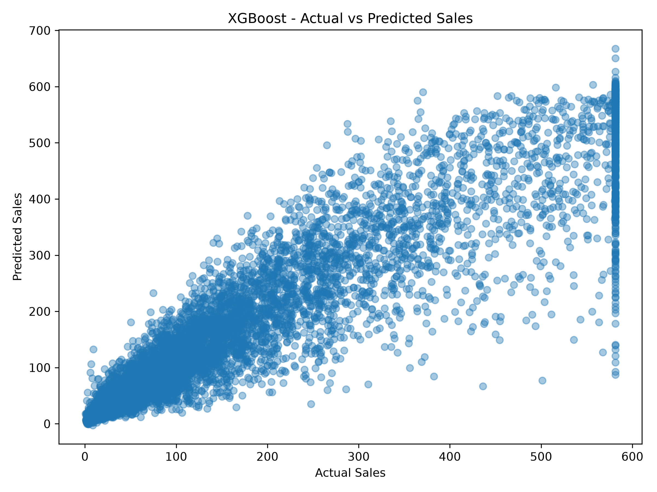
Results: Final Model (XGBoost)
Persisted as Final_XGBoost_Sales_Model.pkl and reused by both scenario scripts
32.85
57.04
0.9116
MAE
RMSE
R squared
Interpretation
The model explains about 91% of the variance in transaction-level sales on unseen data
Average absolute error of roughly 33 currency units per transaction, against a capped mean sale of about 172
RMSE well above MAE indicates a minority of larger errors, most likely on high-value transactions
Because outliers were capped before training, performance on genuinely extreme transactions is untested
Figure 4: Actual versus predicted sales, XGBoost test set (05_XGBoost)
Actual-versus-predicted plots are also saved for Linear Regression, Decision Tree and Random Forest in their respective output folders.

Slide 14
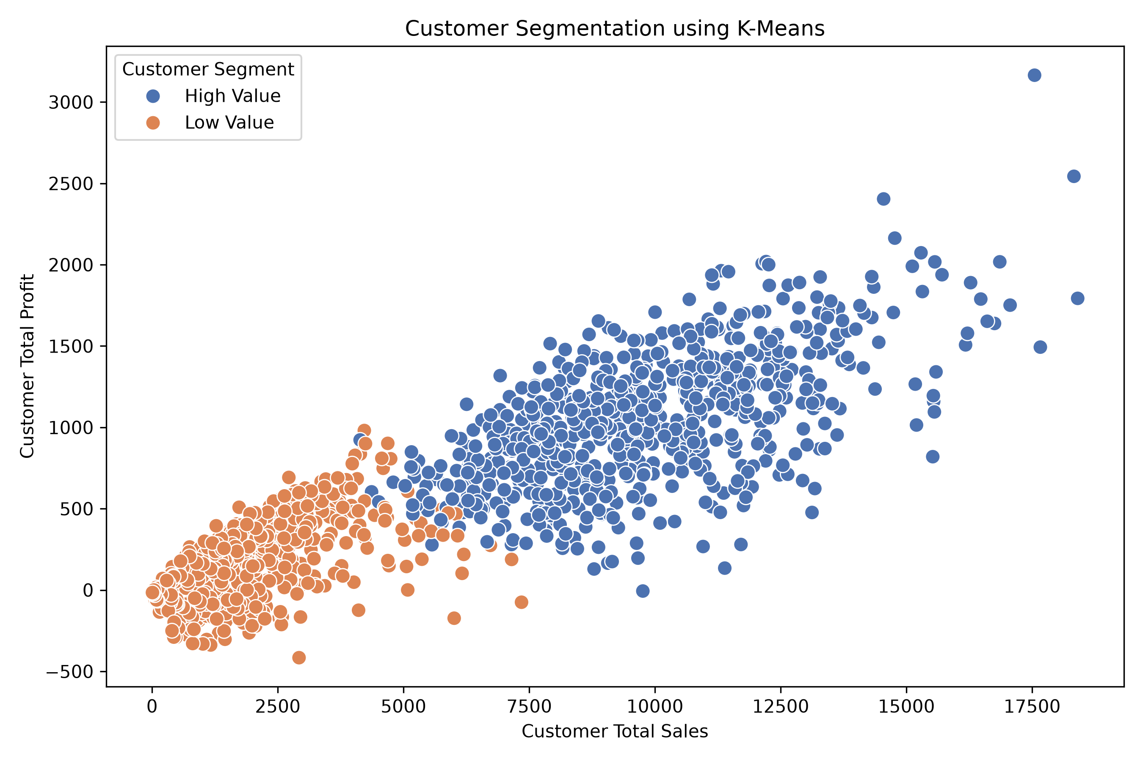
Results: Customer Segmentation (K-Means)
Unsupervised clustering on three engineered customer-level features
Method
Clustering features: Customer Order Count, Customer Total Sales, Customer Total Profit
Silhouette scores evaluated for k = 2 to 6; k = 2 scored highest at 0.6666
Scores decline steadily as k increases (0.5548 at k=3, down to 0.3532 at k=6)
Cluster | Customers | Avg orders | Avg sales | Avg profit
0 - High Value | 755 | 26.48 | 9,760.24 | 1,041.56
1 - Low Value | 835 | 6.90 | 1,762.06 | 169.56
Table 3: Cluster profile (Customer_Segment_Summary.xlsx)
Note on k = 2
The silhouette score favours two clusters, but a two-way split is coarse for marketing use. The separation is large - the high-value cluster averages about 5.5 times the sales and 6.1 times the profit of the low-value cluster - which is why RFM was added as a second, finer segmentation.
Figure 5: K-Means customer clusters (07_Customer_Segmentation)

Slide 15
Results: RFM Customer Intelligence
rfm_analysis.py - quintile scoring of 1,590 customers
How the scores were built
Value band | Customers | Share | Total sales | Total profit | Avg RFM
High Value | 515 | 32.4% | 5,484,204 | 578,661 | 13.23
Medium Value | 461 | 29.0% | 2,510,516 | 269,763 | 9.59
Low Value | 614 | 38.6% | 845,582 | 79,537 | 5.01
Analysis date set to the latest order date plus one day
Recency: days since the customer's most recent order (lower is better)
Frequency: count of distinct Order IDs
Monetary: sum of Sales for the customer
Each dimension ranked and cut into 5 quintiles scoring 1 to 5; Recency reversed so recent buyers score high
RFM Score = R + F + M, giving a range of 3 to 15
Value bands: 12 and above = High, 8 to 11 = Medium, below 8 = Low
Table 4: Customer value distribution (RFM_Customer_Value.xlsx)
Concentration finding
The 515 High Value customers (32.4% of the base) account for 5.48 M of 8.84 M in sales - about 62% of total capped revenue
The 614 Low Value customers (38.6% of the base) contribute only 845,582, roughly 9.6% of sales
High Value customers also carry the strongest profit contribution at 578,661
This supports differentiated retention effort: the largest group by headcount is the smallest by value
1,590
85.4
16.2
Customers
Avg recency (days)
Avg frequency
Average RFM score across the base is exactly 9.00, which is expected because quintile scoring is balanced by construction.

Slide 16
Results: Customer Lifetime Value
clv_analysis.py - a historical behavioural estimate, not a predictive forecast
Formula as implemented
CLV band | Customers | Total CLV | Average CLV | Total profit
High CLV | 525 | 5,744,880 | 10,942.63 | 608,480
Medium CLV | 540 | 2,570,534 | 4,760.25 | 276,406
Low CLV | 525 | 556,882 | 1,060.73 | 43,075
CLV = Average Order Value x Purchase Frequency x Estimated Lifespan
Average Order Value = Total Sales / Order Count | Purchase Frequency = Order Count | Estimated Lifespan = max(Recency / 365, 1) years
Table 5: CLV bands split at the 33rd and 67th percentiles (Customer_CLV.xlsx)
8.87 M
5,580
Limitations of this CLV estimate
It is descriptive, not predictive: it summarises past behaviour and does not forecast future revenue
Lifespan is derived from Recency, so a customer who has not purchased recently receives a longer assumed lifespan - this inflates the CLV of lapsed customers
No churn probability, discount rate or gross-margin adjustment is applied
Because AOV x Frequency reduces to Total Sales, CLV is effectively Total Sales scaled by the lifespan factor
Values are based on capped Sales, so they understate true monetary value
Total CLV
Average CLV
4,178
7.17 - 18,405
Median CLV
CLV range
Notes:
This slide should be expected to attract questions. The lifespan-from-recency issue is a genuine methodological weakness and is better acknowledged than defended.

Slide 17
Results: Discount Scenario Analysis
Saved XGBoost model replayed on a fixed random sample of 1,000 transactions (random_state = 42)
Discount | Avg predicted sales | Total predicted sales | Change vs 0% | % change
0% | 180.60 | 180,596.05 | baseline | 0.00%
5% | 180.92 | 180,919.17 | +323.13 | +0.18%
10% | 180.75 | 180,748.80 | +152.75 | +0.08%
15% | 179.35 | 179,353.25 | -1,242.80 | -0.69%
20% | 172.54 | 172,540.25 | -8,055.80 | -4.46%
30% | 171.13 | 171,126.73 | -9,469.31 | -5.24%
40% | 166.86 | 166,855.66 | -13,740.39 | -7.61%
50% | 159.76 | 159,763.63 | -20,832.42 | -11.54%
Reading the results
Predicted sales are broadly flat up to a 10% discount, then decline steadily
The steepest single drop occurs between 15% and 20%
At 50% discount, predicted sales fall about 11.5% below the zero-discount baseline
The pattern is consistent with the EDA finding that deep discounts coincide with weaker outcomes
How to interpret this correctly
Table 6: Discount scenarios (Discount_Scenario.xlsx). 25%, 35% and 45% levels were also run and are omitted here for space.
These are model outputs, not experimental results. The model learned associations in historical data where deeper discounts tended to appear on particular products and orders. Changing the Discount field shows what the model predicts for otherwise identical records - it does not establish that lowering discounts would cause sales to rise.

Slide 18
Results: Quantity Scenario Analysis
Same 1,000-row sample and same saved model; baseline is the model's prediction on unmodified rows
Quantity | Avg predicted sales | Total predicted sales | Change vs baseline | % change
1 | 152.64 | 152,644.53 | -22,720.84 | -12.96%
2 | 165.06 | 165,062.94 | -10,302.44 | -5.87%
3 | 175.04 | 175,036.08 | -329.30 | -0.19%
4 | 185.24 | 185,236.00 | +9,870.62 | +5.63%
5 | 192.41 | 192,406.42 | +17,041.05 | +9.72%
6 | 197.82 | 197,822.50 | +22,457.12 | +12.81%
8 | 208.06 | 208,056.84 | +32,691.47 | +18.64%
10 | 221.86 | 221,856.38 | +46,491.00 | +26.51%
12 | 221.86 | 221,856.38 | +46,491.00 | +26.51%
Observations
Predicted sales rise monotonically with quantity, as expected for a revenue-like target
The crossover point sits near quantity 3, close to the sample's typical basket size
Predictions at quantity 10 and quantity 12 are identical to the last decimal
Why 10 and 12 match
Both values fall in the same 'High Quantity' bucket and, more importantly, the gradient-boosted trees split on Quantity only at thresholds observed during training. Quantity was IQR-capped during preprocessing, so the model has no split points beyond that cap and returns a constant prediction above it. This is a saturation artefact of the model, not evidence that sales plateau at ten units.
Table 7: Quantity scenarios (Quantity_Scenario.xlsx)
Notes:
A likely examiner question. The honest answer is tree saturation beyond the capped training range.

Slide 19
Power BI Dashboard: Structure
Six report pages at 1920 x 1080; structure extracted from the .pbix report definition
Overview
10 visuals
Product & Profit Analysis
5 visuals
1
4 KPI cards, sales trend line, sales by region and category, three slicers
2
Profit by category, sub-category and region; sales by sub-category and ship mode
Customer Intelligence
6 visuals
Customer CLV
5 visuals
3
RFM table, value donut, monetary by value band, 2 cards, value slicer
4
CLV table, total CLV by band, Total CLV and Average CLV cards, band slicer
Scenario Analysis
6 visuals
Business Insights
1 visual
5
Discount and quantity comparison tables, two impact line charts, two slicers
6
Written summary of findings across the six themes
Live screenshots should be captured from Power BI Desktop and inserted before submission. The page names, visual counts, chart types, bound fields and slicers described here were read directly from the .pbix file.
Notes:
The .pbix uses the newer PBIR folder format, so the report definition is readable JSON. The DataModel part is compressed and was not decoded, so no DAX expressions are quoted.

Slide 20
Power BI: Overview and Product Analysis Pages
KPI cards are driven by DAX measures over the MySQL sales_data table
Page 1 - Overview
Page 2 - Product & Profit Analysis
Purpose: single-screen summary of overall business performance.
Purpose: separate revenue performance from profitability.
Total Sales
Total Profit
Total Quantity
Total Orders
Profit by Category - clustered column chart
Profit by Sub-Category - clustered bar chart, ranks all 17 sub-categories
Profit by Region - clustered bar chart
Sales by Sub-Category - clustered bar chart, paired with the profit view
Sales by Ship Mode - clustered column chart
Business use: identifying products and regions where high sales do not translate into profit, for example Chairs and Southeast Asia
Sales Trend Over Time - line chart, Total Sales by order_date
Sales by Region - clustered bar chart, Total Sales by region
Sales by Category - clustered column chart, Total Sales by category
Slicers: Filter by Category, Filter by Market, Filter by Order Year
Business use: month-by-month performance monitoring and drill-down by market or year
Source table: retail_analytics sales_data (MySQL import)
This page carries no slicers; it is read alongside the Overview filters

Slide 21
Power BI: Customer and Scenario Pages
These pages are bound to the Excel outputs of the Python pipeline
Page 3 - Customer Intelligence
Page 4 - Customer CLV
Page 5 - Scenario Analysis
Source: RFM_Customer_Data
Source: Customer_CLV_Data
Source: Discount_Scenarios, Quantity_Scenarios
Cards: Total Customers, Average RFM Score
Donut: customer count by Customer_Value band
Bar: total Monetary by Customer_Value
Table: Customer ID, Recency, Frequency, Monetary, RFM_Score, Customer_Value
Slicer: Customer_Value
Cards: Total CLV, Average CLV
Column: total CLV by CLV_Category
Table: Customer ID, Total_Sales, Order_Count, CLV, CLV_Category
Slicer: CLV_Category
Table: Discount Scenario Comparison (all five columns)
Table: Quantity Scenario Comparison
Line: Impact of Discount on Predicted Sales
Line: Impact of Quantity on Predicted Sales
Slicers: Select Discount, Select Quantity
Business use: identifying which customers to prioritise for retention and which are drifting toward lapse.
Business use: ranking customers by estimated historical value to guide loyalty and account-management effort.
Business use: examining how the model's predicted sales respond to different pricing and basket-size assumptions.
Page 6 - Business Insights: a written summary covering sales performance, product performance, regional performance, customer intelligence, customer lifetime value and scenario analysis. It correctly describes the scenario pages as showing how the model's predicted sales change under different inputs rather than as measured business outcomes.
Notes:
The Average RFM Score, Total CLV and Average CLV measures are hosted in the Baseline_Data table in the model. Measures can live in any table, but relocating them to RFM_Customer_Data and Customer_CLV_Data would be tidier.

Slide 22
Performance Evaluation
What was measured, and how the pipeline was validated
Model evaluation
Limitations and possible sources of error
Held-out testing: 10,258 rows never seen during training, fixed seed for reproducibility
Three complementary regression metrics reported for all four models
Actual-versus-predicted scatter plots saved for every model, giving a visual residual check
Clustering evaluated separately using silhouette scores across k = 2 to 6
No cross-validation: metrics come from a single train/test split, so they carry sampling variance
No hyperparameter tuning: all four models use library defaults, so the comparison reflects default behaviour rather than tuned potential
IQR capping removes the hardest cases before training, which inflates apparent performance relative to raw data
Possible leakage risk: Shipping Cost is a predictor of Sales and is often derived from order value; its inclusion may make the task easier than genuine forecasting
No temporal split: rows spanning 2011-2014 were shuffled randomly, so the model interpolates rather than forecasts forward
Scenario predictions have no ground truth; the counterfactual discount levels were never observed
Data quality validation
51,290
0
0
0
Figure 6: RMSE comparison, values from Model_Comparison.xlsx
rows end to end
missing values
duplicate rows
invalid dates
Notes:
The Shipping Cost leakage point and the absence of a temporal split are the two most likely technical questions from a panel. Both are acknowledged rather than hidden.

Slide 23
Research Context and Contribution
Framed cautiously - no claim of worldwide novelty is made
Existing approach
This project's approach
Where the contribution lies
Retail reporting is historically descriptive: periodic sales and profit summaries
Segmentation, if performed, is usually demographic or by business unit
Discount decisions rest on experience and margin rules of thumb
Analytical outputs stay in spreadsheets, separate from any model
Descriptive EDA and predictive modelling in one reproducible pipeline
Behavioural segmentation via both K-Means and RFM scoring
CLV estimation layered on the RFM output
A trained model reused as a simulation engine for discount and quantity
All strands surfaced in a single six-page dashboard
Each individual component - regression on retail data, RFM, CLV, K-Means, Power BI reporting - is well established in the literature and in commercial practice. The contribution here is integrative rather than methodological: assembling these components into one traceable pipeline on a single dataset, where the model trained for prediction is the same artefact reused for scenario simulation, and where every stage writes an inspectable output.
Research gap addressed, stated carefully
Much applied retail analytics work treats prediction, customer segmentation and lifetime value as separate exercises with separate outputs. This project demonstrates an end-to-end linkage between them on one dataset. It does not claim to introduce a new algorithm, a new CLV formulation, or a result that is novel in the published literature. A formal literature review would be required before making any stronger claim, and the scenario component in particular would need a causal design to support prescriptive recommendations.

Slide 24
Limitations
Stated explicitly so that the results are read correctly
Data
IQR capping reduces total sales by about 30% and profit by about 37% versus the raw file. Every headline figure in this deck is a post-capping value.
Modelling
Single train/test split, default hyperparameters, no cross-validation. Shipping Cost may leak information about Sales.
Temporal
Rows are split randomly rather than chronologically, so the model interpolates within 2011-2014 and has not been tested as a forward forecaster.
Scenarios
Outputs are model predictions under altered inputs, not causal effects. Quantity predictions saturate above the capped training range, which is why 10 and 12 units return identical values.
CLV
A historical behavioural estimate. Lifespan derived from Recency inflates the value of lapsed customers; no churn, margin or discount rate is modelled.
Pipeline
Scripts use absolute Windows paths and are run individually; main.py is empty, so there is no single orchestrated entry point. Dashboard refresh is manual.
Dashboard
Power BI imports static extracts. No live or scheduled refresh was configured, so the report reflects the state of the files at import time.
Notes:
Presenting limitations proactively is usually received better than having a panel surface them.

Slide 25
Conclusion and Future Scope
Separating what was built from what is proposed
Delivered in this project
Proposed future work (not implemented)
A reproducible preprocessing stage that validates 51,290 records to zero missing values and zero duplicates
An EDA layer producing 24 result tables and more than 30 saved charts
27 engineered features and a documented feature screening study
Four regression models compared on identical data, with XGBoost best at MAE 32.85, RMSE 57.04 and R squared 0.9116
K-Means clustering (k = 2, silhouette 0.667) and RFM scoring of all 1,590 customers
CLV estimation totalling 8.87 M with a three-band classification
Discount and quantity scenario simulation using the persisted model
A six-page Power BI dashboard over MySQL and Excel sources
Cross-validation and hyperparameter tuning to give more reliable and better-optimised metrics
A chronological train/test split, and time-series forecasting (ARIMA, Prophet or LSTM) for genuine demand prediction
Probabilistic CLV models such as BG/NBD with Gamma-Gamma, incorporating churn and margin
A causal design for discount effects - uplift modelling or a controlled pricing experiment
Finer customer segmentation, including RFM-cluster hybrids and segment-specific models
Model deployment as an API so predictions can be served rather than replayed offline
Scheduled or DirectQuery refresh to move the dashboard from static extracts toward live reporting
All figures quoted in this presentation were extracted directly from the project output files. Values affected by outlier capping are identified as such.

